Slide 1
Macros for multicolor gradients – Content
General
Copy the library – export
Copy the library – import
Structure of a multicolor gradient
Inspect structure of a multicolor gradient
Content of the Library
Using a macro
Input boxes
Modify color or transparency
Add stop
Modify offset
Delete stop
Transparency
Further tips

Slide 2
General
The new "Multicolor gradient" (MCGR) feature does not yet have a user interface. Manipulating such multicolor gradients is currently only possible by editing the file markup or by using macros.
This document contains a BASIC library of macros that help playing around with multicolor gradients. Another intension for these macros is to show how the new Gradient2 struct and StopColor struct in the SDK API reference can be uses in BASIC macros.
Although they have been tested, the macros are not in a "professional" state and are therefore not offered as an extension. There are no comfortable dialogs, but the interactions are done via message boxes and input boxes.
The macros are written for use in Draw and Impress. They could also work in Writer or Calc, but that has not been tested.
The macros are not intended for productive use and are provided without any warranty.
On the following slides you will find some hints to how to use the macros.
Have fun with them!

Slide 3
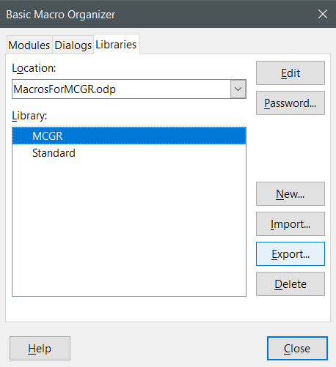
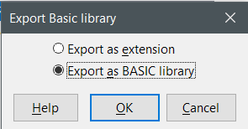
Copy the library – export
Open Basic Macro Organizer
e.g.: Alt+F11 > Organizer > tab Libraries
Select this file in Location list, select MCGR in Library field.
Click on Export
Select Export as BASIC library.
Select a folder. The export creates a subfolder MCGR therein.

Slide 4
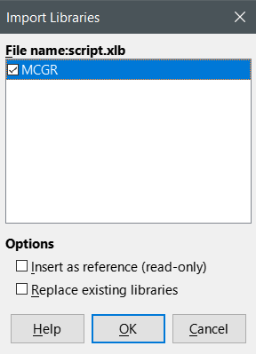
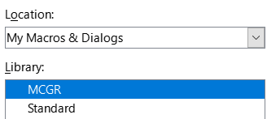
Copy the library – import
Open Basic Macro Organizer
e.g.: Alt+F11 > Organizer > tab Libraries
Select My Macros & Dialogs in Location list.
Click on Import, go to the MCGR subfolder and open it.
Select script.xlb file and then click Open button.
Click on OK in Import Libraries dialog.
Now you have the MCGR library in your user directory and can use it for other documents.

Slide 5
Structure of a multicolor gradient
A multicolor gradient is a sequence of gradient stops. A single gradient stop consists of an offset and a color. The sequence must be ordered by the offset.
The offset describes the relative position of the color in the gradient. Its value is of data type double and must be in range 0..1.
The color is a RGB-color without alpha channel. Transparency can be applied by a separate transparency gradient.
gradient with three stops
transition start 16%
0
0.2
0.4
0.6
0.8
1

Slide 6
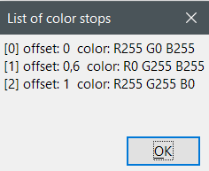
Inspect structure of a multicolor gradient
The macros *_Show_List_of_Stops give you an overview of the existing stops in a gradient, and the other macros show you such list at the top of the input box.
R255 G0 B255
R0 G255 B255
R255 G255 B0
[0]
[1]
[2]
0
0.2
0.4
0.6
0.8
1

Slide 7
Content of the Library
The MCGR library contains the following modules:
Page_Background
Shape_Color
Shape_Transparency
Tools
ToolsArray
ToolsGradientTable
The macros in the Tools, ToolsArray and ToolsGradientTable modules are not intended for direct use, but are called by other macros.
The macros are written for manipulating the gradient stops sequence. To change the gradient type, the rotation angle, the center position or the transition start, continue to use the Area dialog or Background dialog, respectively.
The names of the macros should tell you their purpose. In addition you can look at the comments in the macro source code. For some of the macros their use is shown on the next slides.

Slide 8
Using a macro
Make sure that the shape or background has already a gradient assigned. You can do that in the Area dialog of the shape or in the Background dialog of the page or slide.
The macros work on a single selected shape or on the current active page or slide. You can neither use them with a multi-selection nor with a group.
The way to use a macro is always the same:
Open the BASIC macros dialog, e.g. with Alt+F11.
Select the library MCGR on the left.
Expand the + sign and select a modul.
Select the desired macro on the right.
Click on Run button.
In case you are interested in the source code, use the Edit button to open the BASIC IDE.

Slide 9
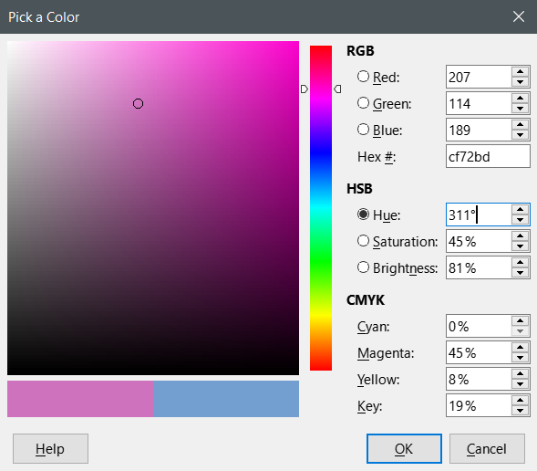
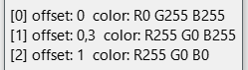
Input boxes
All input boxes show you a list of the current stops in the gradient.
The position in this sequence is the index of a stop, written with square brackets.
The offset is a decimal value in the range 0 to 1. Its decimal separator is local dependent.
A color is given by its Red, Green and Blue component. You find these values in the Pick a Color dialog.
A transparency is given as percent value in the range 0% to 100%, where 100% means full transparent.

Slide 10
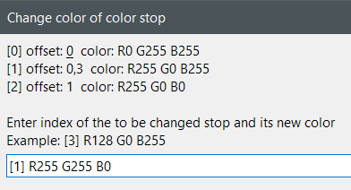
Modify color or transparency
We want to use Yellow instead of Magenta.
Use macro ShapeColor_Modify_Stop_Color
with the below input

Slide 11
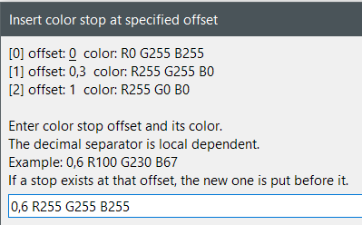
Add stop
We want to add White between Yellow and Red.
Use macro ShapeColor_Add_Stop with the below input.
Notice that the decimal separator is local dependent, here for German local.

Slide 12
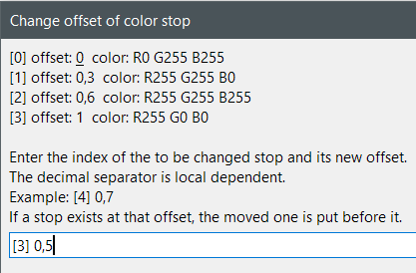
Modify offset
We want to move the red stop between Yellow and White.
Use the macro ShapeColor_Modify_Stop_Offset.
The input box shows you the state of the color stops before applying the macro.
The red stop has index [3]. You need an offset between 0.3 and 0.6.

Slide 13
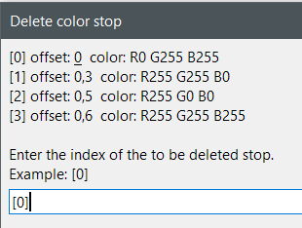
Delete stop
We want to delete the outer cyan stop.
Use the macro ShapeColor_Delete_Stop. Notice that a gradient needs at least two stops.

Slide 14
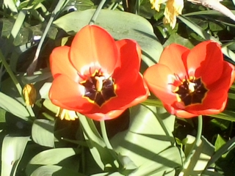
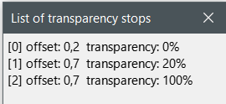
Transparency
Transparency gradients work similar to color gradients. Only the stop value is not a color but a percent value for the transparency.
A transparency gradient can be combined with a solid color fill.
A page background cannot have transparency.
The Transparency_Show_List_of_Stops macro shows the used settings for the shape at the right.
To make the transparency better visible, I have put an image behing the shape.
Using two stops with same offset results in the sharp change from 20% to 100% transparency.
The value 100% at the last stop is extended to the end of the gradient.
The value 0% at the first stop is extended to the start of the gradient.

Slide 15
Further tips
The document InfoPresentation_MultiColor_Gradients_LO76.odp, linked in the Release Notes 7.6, contains hints, what you can already do with multicolor gradients and current user interface.
When you play around with the macros, you should work on a new document. When you then have created a nice gradient, which you want to keep, follow the tips in that document.
Do not use the sidebar to change the color. There is currently the bug, that the gradient geometry (type, center, angle, transition start) will be reset to default values.
If the “Increment” is set to a value in the Area dialog, the stepped rendering will be applied to each section between every two stops.
To create a color transition with a sharp change from one color to another, use two color stops with the same offset.
The start stop need not have offset 0 and the end stop need not have offset 1. That allows to set wider areas of constant color at the begin and end of the grandient.

